Slide 1
Individual Homework
Exercise 5.1 – Boolean functions
Astăluș adrian claudiu

Slide 2
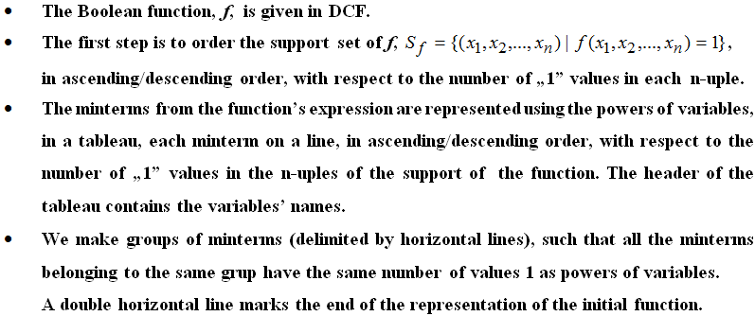
Exercise 5.1 - Using Quine’s method, simplify the following Boolean functions given by their values 0.
f₁(0,1,0) = f₁(0,1,1) = f₁(1,0,1) = 0
f₁ is a Boolean function of 3 variables: f₁: (B₂)^{n} → B₂
When using the Quine – McClusky’s method, there are (quite) a few steps to follow:

Slide 3
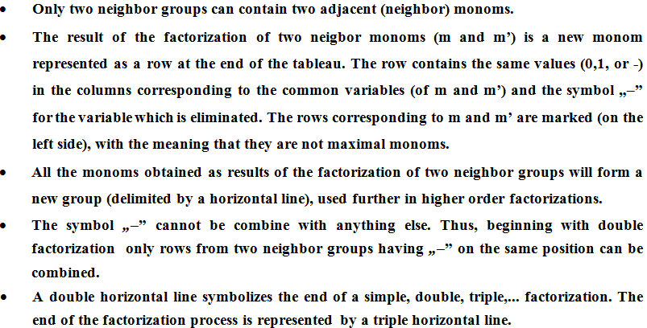
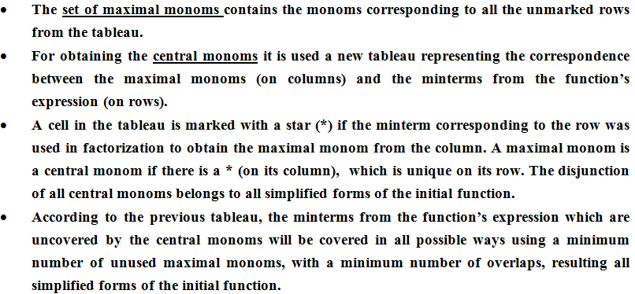

Slide 4

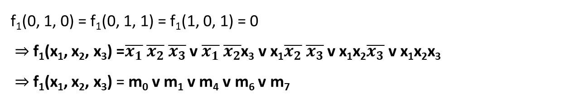
Solving the exercise
Knowing the values 0 of the function, we can determine the DCF of the function
° A DCF (disjunctive canonical form) is a disjunction of monoms
(minterms in our case)
° A monom is a conjunction of variable (in our case, x₁, x₂ and x₃)
x₁ | x₂ | x₃ | F₁(x₁, x₂, x₃)
0 | 0 | 0 | 1
0 | 0 | 1 | 1
0 | 1 | 0 | 0
0 | 1 | 1 | 0
1 | 0 | 0 | 1
1 | 0 | 1 | 0
1 | 1 | 0 | 1
1 | 1 | 1 | 1
f₁(0, 1, 0) = f₁(0, 1, 1) = f₁(1, 0, 1) = 0
⇒ f₁(x₁, x₂, x₃) =$\overline{x_{1}} \overline{x_{2}} \overline{x_{3}}$ v $\overline{x_{1}} \overline{x_{2}}$x₃ v x₁$\overline{x_{2}} \overline{x_{3}}$ v x₁x₂$\overline{x_{3}}$ v x₁x₂x₃
⇒ f₁(x₁, x₂, x₃) = m₀ v m₁ v m₄ v m₆ v m₇
From here, we can write the support set of f, as follows:
S_{f} = { (0, 0, 0), (0, 0, 1), (1, 0, 0), (1, 1, 0), (1, 1, 1) }
The support set is ordered in ascending order with respect to the number of “1” values in each triple
- the support set of f -

Slide 5
Based on the support set of f, we make groups of minterms (delimited by horizontal lines), such that all the minterms belonging to the same group have the same number of values 1 as powers of variables. A double horizontal line marks the end of the representation of our initial function.
Therefore, from our support set of f₁, we can determine 4 such groups:
- Group I, having the minterm (0, 0, 0) – m₀
- Group II, having the minterms (1, 0, 0) and (0, 0, 1) – m₄ and m₁
- Group III, having the minterm (1, 1, 0) – m₆
- Group IV, having the minterm (1, 1, 1) – m₇
We take each neighboring groups ( I and II, II and III, III and IV) and apply the simple factorization. The result of the factorization of two neighbor monoms is a new monom represented as a row at the end of the tableau. The row contains the same values (0, 1 or -) in the columns corresponding to the common variables, where the symbol “-” is used when the variable is eliminated. The rows corresponding to the ‘factorized’ monoms are marked on the left side, meaning that they are not maximal monoms.

Slide 6
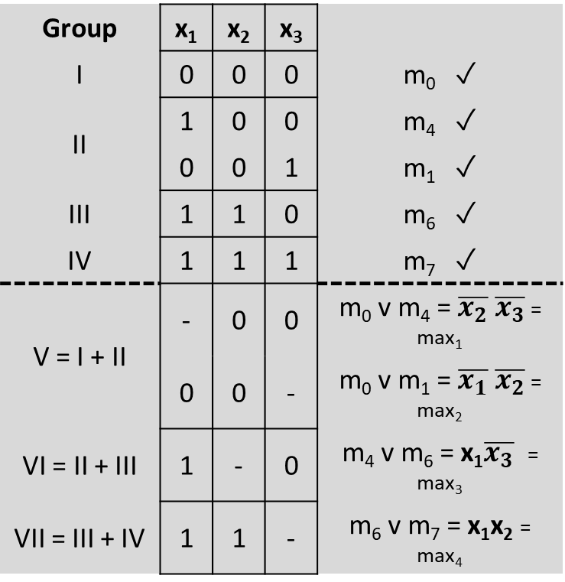
Group | x₁ | x₂ | x₃
I | 0 | 0 | 0 | m₀ ✓
II | 1 | 0 | 0 | m₄ ✓
 | 0 | 0 | 1 | m₁ ✓
III | 1 | 1 | 0 | m₆ ✓
IV | 1 | 1 | 1 | m₇ ✓
V = I + II | - | 0 | 0 | m₀ v m₄ = $\overline{x_{2}} \overline{x_{3}}$ = max₁
 | 0 | 0 | - | m₀ v m₁ = $\overline{x_{1}} \overline{x_{2}}$ = max₂
VI = II + III | 1 | - | 0 | m₄ v m₆ = x₁$\overline{x_{3}}$ = max₃
VII = III + IV | 1 | 1 | - | m₆ v m₇ = x₁x₂ = max₄
For the groups V, VI and VII we use the simple factorization
m₁ and m₆ cannot be factorized because they are not neighbors ( they differ by more than 1 variable)
We cannot apply double factorization because there are no two neighboring monoms ( from groups V and VI or VI and VII) that have a ‘-’ on the same column
The last 4 monoms are not checked, so they form the set of maximal monoms of f
M(f) = { max₁, max₂, max₃, max₄} – the set of maximal monoms of f₁

Slide 7
For obtaining the central monoms we use a new tableau representing the correspondence between the maximal monoms (on columns) and the minterms from the function’s expression (on rows).
A cell in the tableau is marked with a star (*) if the minterm corresponding to the row was used in factorization to obtain the maximal monom from the column.
A maximal monom is a central monom if there is a * on its column that is unique in its row.
The disjunction of all central monoms belongs to all simplified forms of the initial function.
 | max₁ | max₂ | max₃ | max₄
m₀ | ★ | ★ |  |  | - m₀ covered by max₁ and max₂
m₁ |  | ⍟ |  |  | - m₁ covered by max₂
m₄ | ★ |  | ★ |  | - m₄ covered by max₁ and max₃
m₆ |  |  | ★ | ★ | - m₆ covered by max₃ and max₄
m₇ |  |  |  | ⍟ | - m₇ covered by max₄

Slide 8
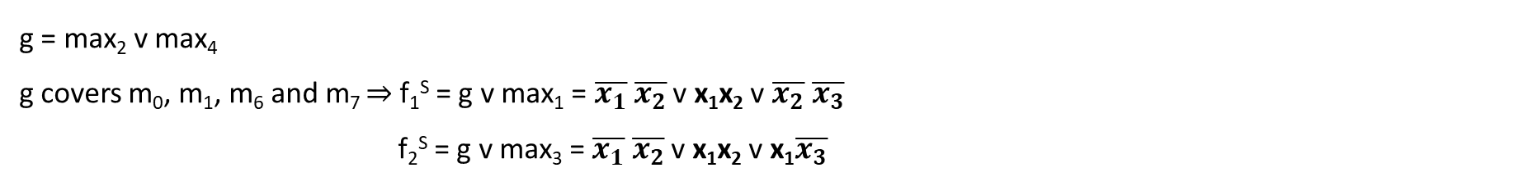
Because m₁ and m₇ are covered by only one maximal monom each, these two maximal monoms will be the central monoms
C(f) = { max₂, max₄ } – the set of central monoms of f₁
M(f) ≠ C(f) ≠ 0 ⇒ we use the 2nd simplification case
g = max₂ v max₄
g covers m₀, m₁, m₆ and m₇ ⇒ f₁^{S} = g v max₁ = $\overline{x_{1}} \overline{x_{2}}$ v x₁x₂ v $\overline{x_{2}} \overline{x_{3}}$
f₂^{S} = g v max₃ = $\overline{x_{1}} \overline{x_{2}}$ v x₁x₂ v x₁$\overline{x_{3}}$
m₄ is not covered by g, so our final functions consist of g and a maximal monom that covers m₄ (in this case, either max₁ or max₃)
 | max₁ | max₂ | max₃ | max₄
m₀ | ★ | ★ |  |  | - m₀ covered by max₁ and max₂
m₁ |  | ⍟ |  |  | - m₁ covered by max₂
m₄ | ★ |  | ★ |  | - m₄ covered by max₁ and max₃
m₆ |  |  | ★ | ★ | - m₆ covered by max₃ and max₄
m₇ |  |  |  | ⍟ | - m₇ covered by max₄

